Slide 1

Neural Style Transfer
Style cost function
deeplearning.ai

Slide 2






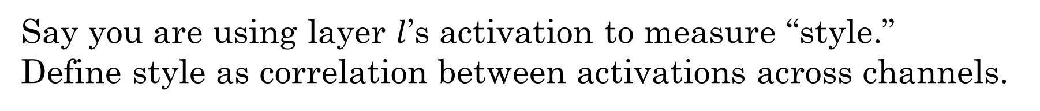
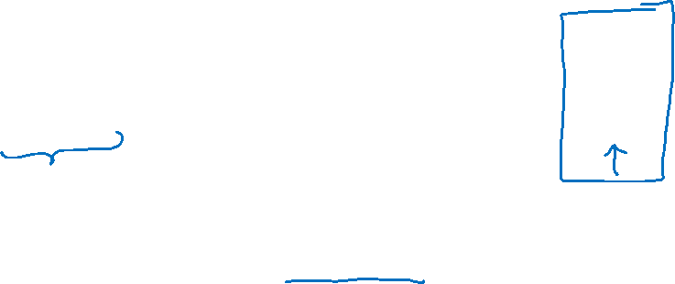
Meaning of the “style” of an image
$$\hat{y}$$
$$⋮$$
Say you are using layer $l$’s activation to measure “style.”
Define style as correlation between activations across channels.
How correlated are the activations across different channels?
$$n_{H}$$
$$n_{C}$$
$$n_{W}$$
[Gatys et al., 2015. A neural algorithm of artistic style]

Slide 3
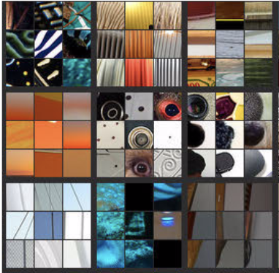
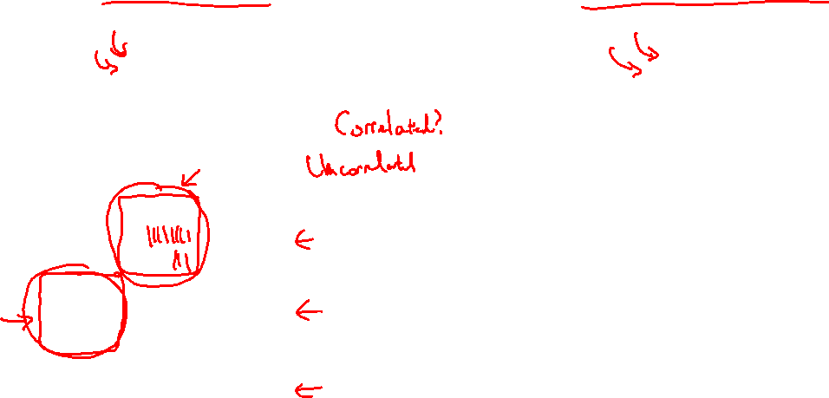



Intuition about style of an image
Style image
Generated Image
$$n_{H}$$
$$n_{H}$$
$$n_{C}$$
$$n_{C}$$
$$n_{W}$$
$$n_{W}$$
[Gatys et al., 2015. A neural algorithm of artistic style]

Slide 4
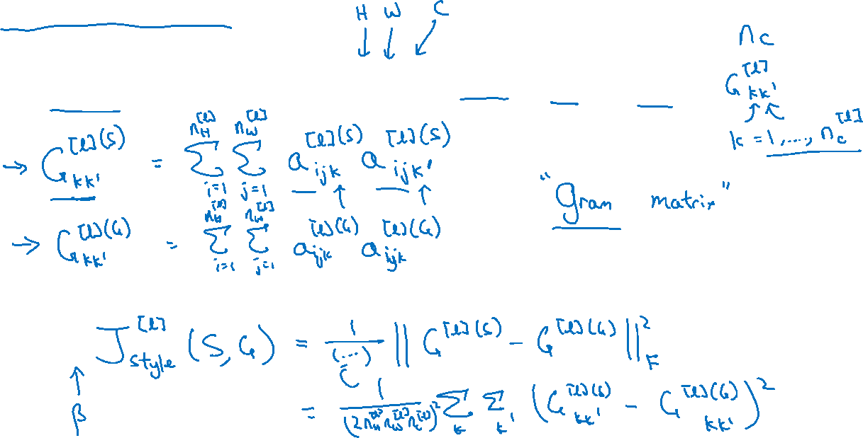
Style matrix
Let $a_{i,j,k}^{[l]}=$ activation at $\left(i,j,k\right). G^{[l]}$ is $n_{c}^{[l]}×n_{c}^{[l]}$
[Gatys et al., 2015. A neural algorithm of artistic style]

Slide 5
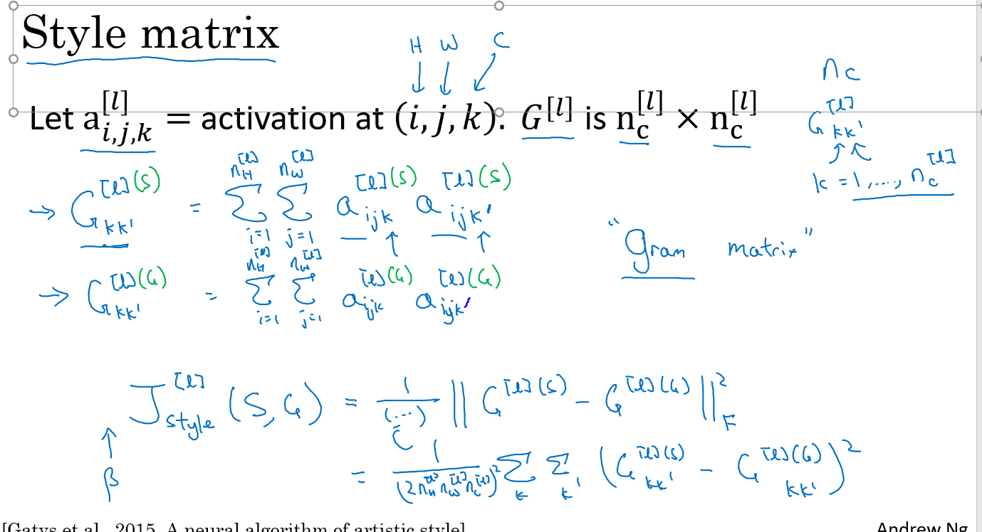

Slide 6
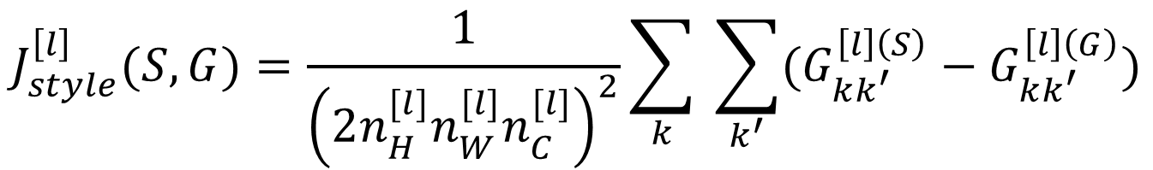
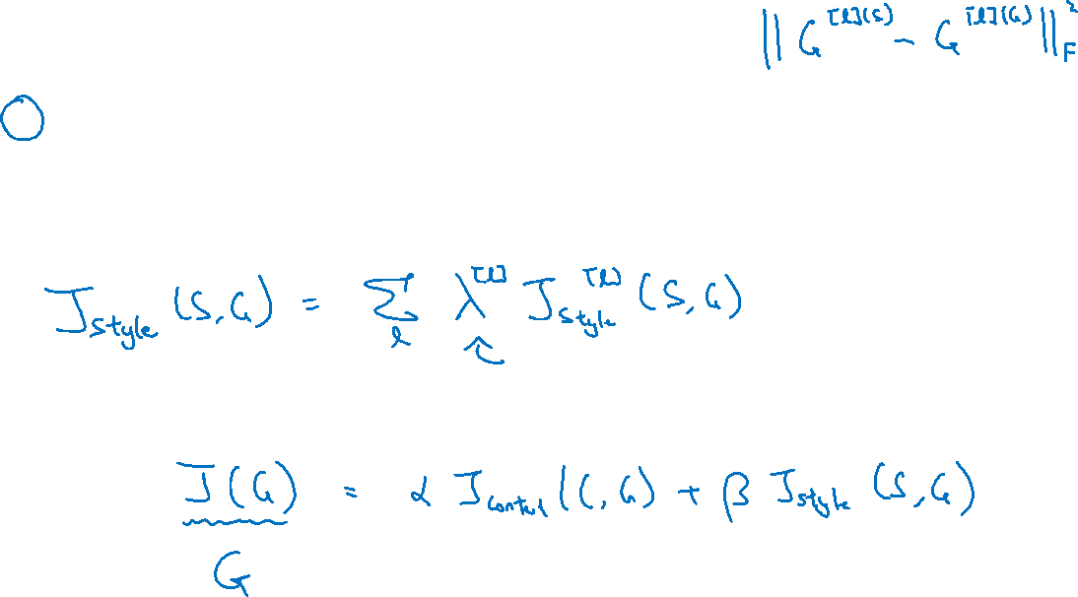
Style cost function
$$J_{style}^{\left[l\right]}(S,G)=\frac{1}{{\left(2n_{H}^{[l]}n_{W}^{[l]}n_{C}^{[l]}\right)}^{2}}\sum_{k}{ \sum_{k^{′}}{(G_{kk^{′}}^{\left[l\right]\left(S\right)}−G_{kk^{′}}^{\left[l\right]\left(G\right)})}}$$
[Gatys et al., 2015. A neural algorithm of artistic style]

